Slide 1

A Cyber Security Project on Image Steganography
Submitted By
GAURAV KUMAR SHARMA - BC/20/029
Submitted to
Department of Computer Science & Information Technology
in partial fulfilment of the required for the award of Degree

Slide 2
Table of Contents
Introduction
Objective
Hardware & Software
Screenshots
Conclusions
Limitation
Future Scope

Slide 3
An Introduction to Image Steganography
This presentation provides an overview of steganography , varieties of steganography
especially image steganography , objective , hardware & software requirements , output screenshots , limitations , and future applications of image steganography.

Slide 4
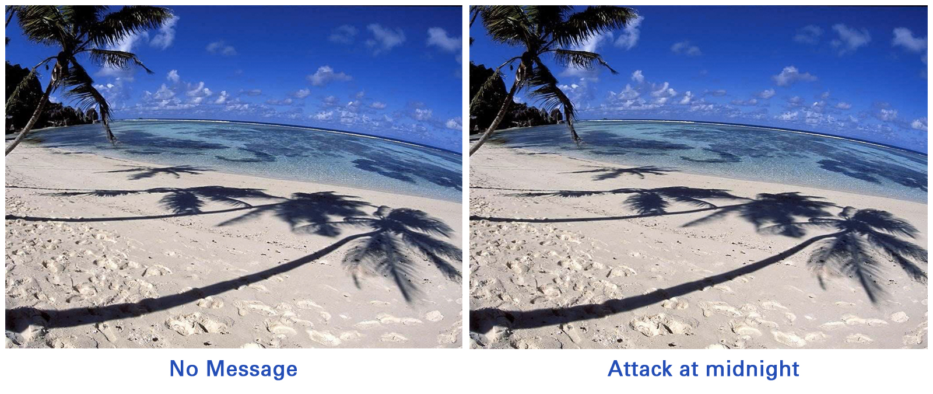
Image Steganography
It can hiding the information by taking the cover object as image is defined as image steganography. In image steganography, pixel intensities are used to conceal the data.
In digital steganography, images are broadly utilized cover source because there are multiple bits presents in computer description of an image.
Few Terms related to Image Steganography :-
Cover-Image - Original image which can be used as a carrier for hidden information
Stego-Image - After embedding message into cover image is called a stego-image
Stego-Key - A key can be used for embedding or deriving the messages from cover-images and stego-images
Photo by Pixabay

Slide 5
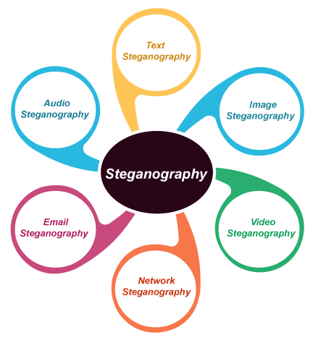
Types of Steganography
Text Steganography
Image Steganography
Video Steganography
Audio Steganography
Network Steganography
Email Steganography
Photo by Pixabay

Slide 6
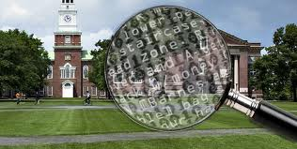
Objective
Confidentiality: Hide sensitive information within an image to ensure its secrecy.
Covert Communication: Enable the exchange of confidential data without arousing suspicion.
Security Enhancement: Provide an additional layer of protection for transmitted information.
Steganalysis Resistance: Make it difficult for adversaries to detect the presence of hidden data.
Photo by Pixabay

Slide 7
Hardware & Software
Hardware Requirements : -
Processor (CPU) – Intel i5 >= or AMD
Memory (RAM) - 4 GB or Higher
Display
Input Devices
Software Requirements : -
Python - Prefer Latest Version
Spyder IDE - For scientific computing with Python
Tkinter - A Standard Python library for creating GUI applications and is included with Python
Additional Python Libraries - PIL ( Python Imaging Library ) , or Pillow etc.
Photo by Pixabay

Slide 8
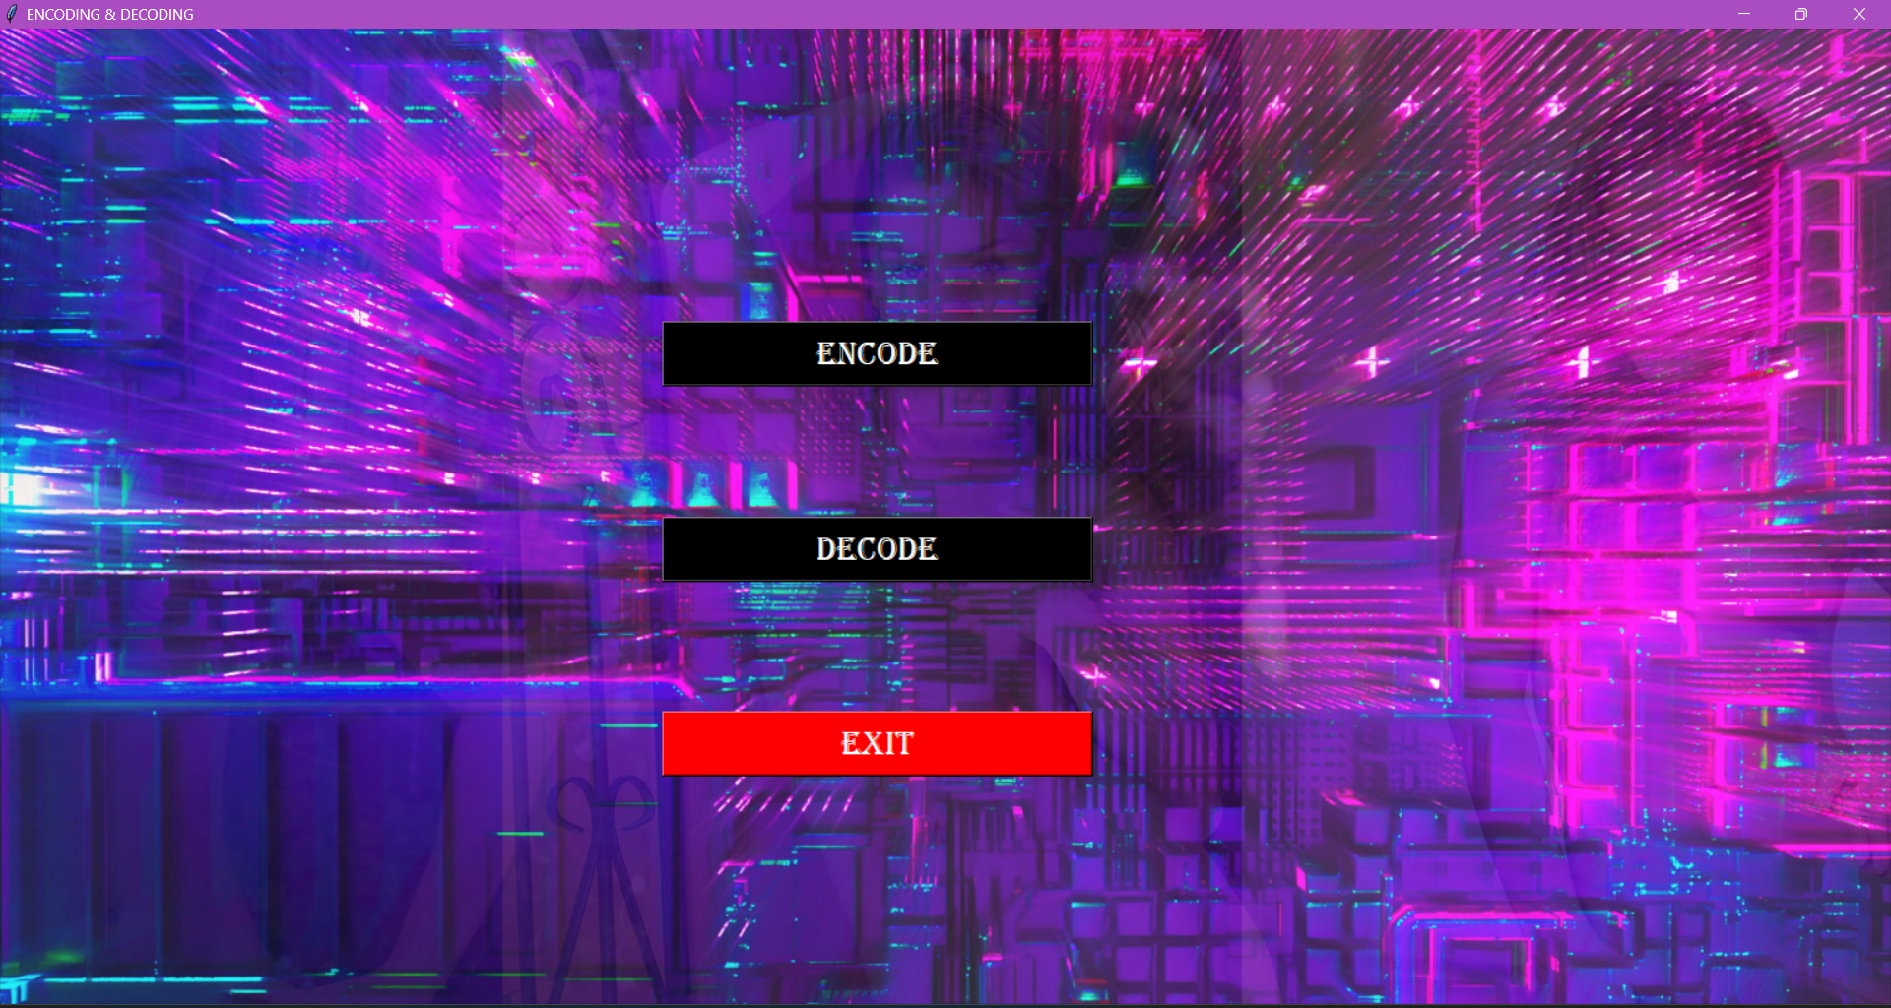
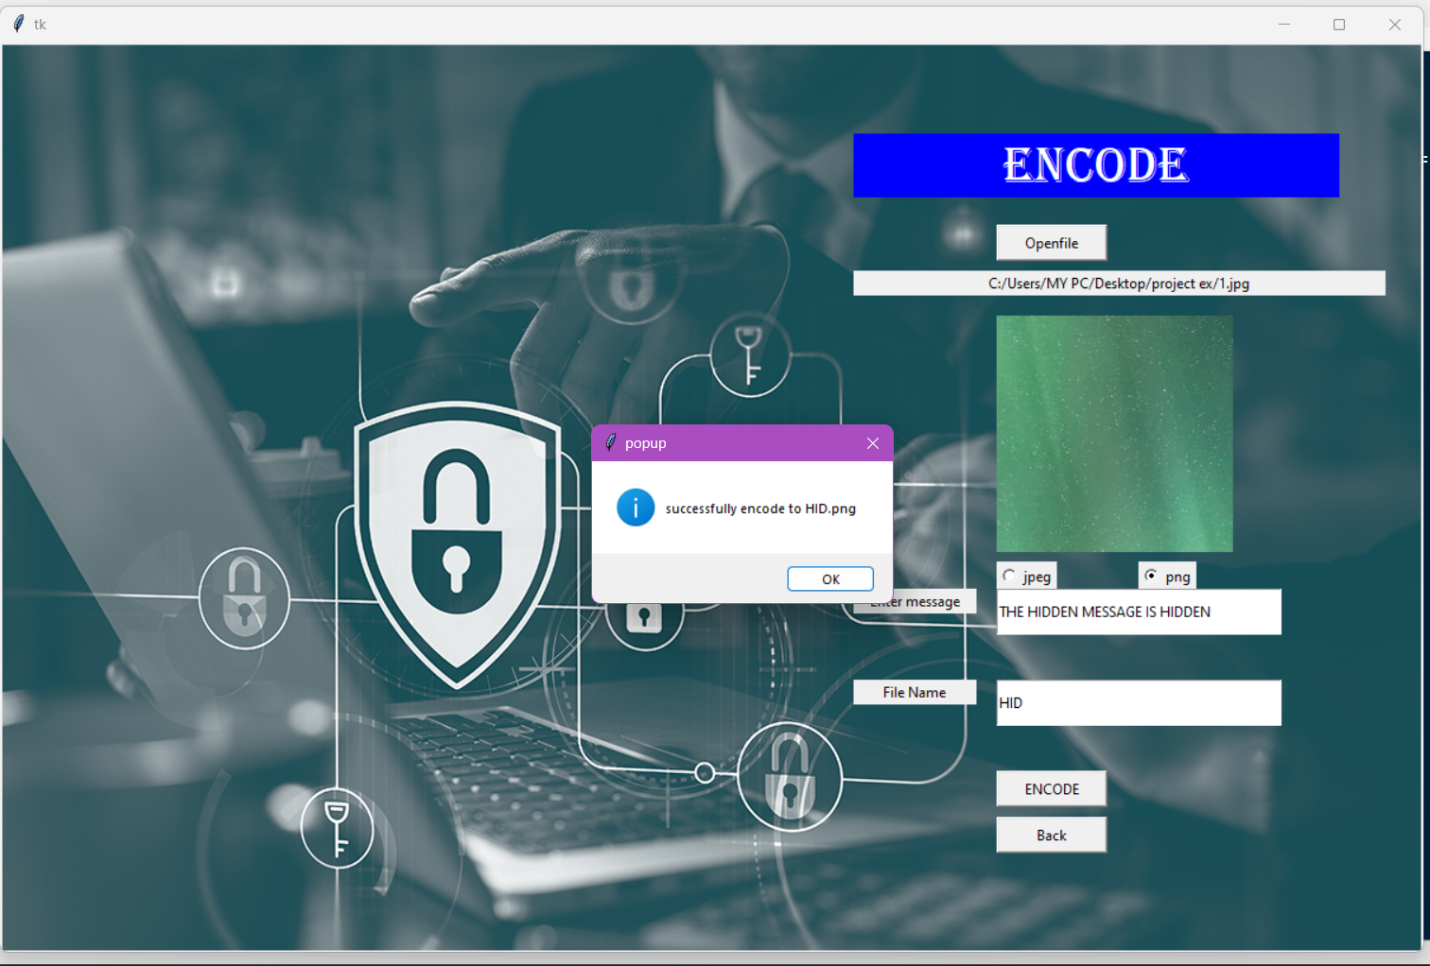
Screenshots
The home window lets the user to choose as to whether he/she desires to encode or decode a message .
The encode lets the user encode a message inside and image of his choice and save as jpg , jpeg , etc . format .
Photo by Pixabay

Slide 9
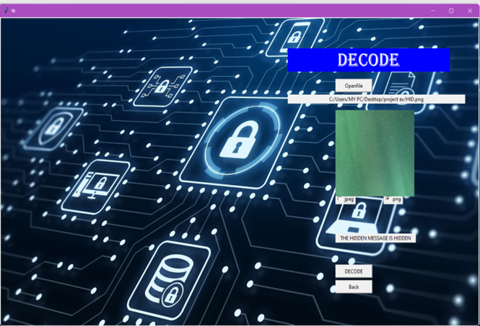
Screenshots
The Decode Window lets the user decode an encoded image using lsb technique and the user can see the encoded message in the image file .
Photo by Pixabay

Slide 10
Conclusion
It is observed that through LSB Substitution Steganographic method, the results obtained in data hiding are pretty impressive as it utilizes the simple fact that any image could be broken up to individual bit-planes each consisting of different levels of information.
It is to be noted that as discussed earlier, this method is only effective for bitmap images as these involve lossless compression techniques.
This process can be extended to be used for color images where, bit-plane slicing is to be done individually for the top four bit-planes for each of R, G, B of the message image, which are again to be placed in the R , G , B planes of the cover image , and extraction is done similarly
Photo by Pixabay

Slide 11
Limitations of Image Steganography
Vulnerability to Detection
Lossy Compression Impact-Lossy compression is a data compression technique that reduces the file size of an image, audio, or video by discarding some of the less important or redundant information.
Limited Payload Size
Security risks in transmission
Ethical and Legal Consideration
Computational Overhead
Photo by Pixabay

Slide 12
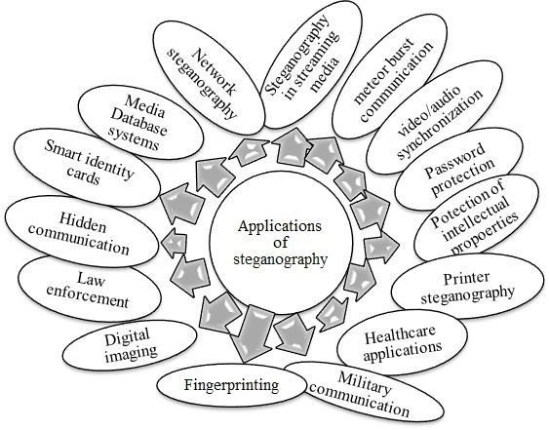
Future Scope of Image Steganography
High Capacity Steganography
Multimedia Steganography
Deep Learning and Artificial Intelligence
Anti-Steganalysis Techniques
It can be utilized in areas such as confidential communication , copyright protection , digital forensics etc.

Slide 13
Thank you.

